Slide 1
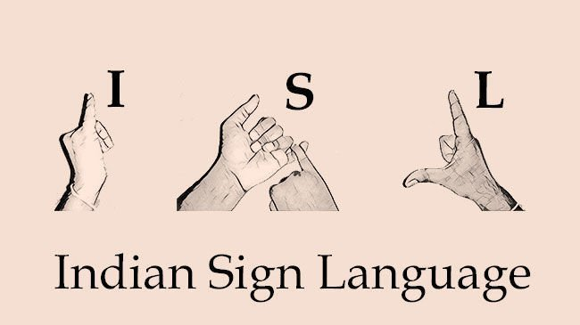
AUDIO TO SIGN LANGUAGE TRANSLATOR

Slide 2
ABSTRACT
This project mainly focuses on developing a translating system consisting of many modules that take English audio and convert the input to English text, which is further parsed to structure grammar representation on which grammar rules of Indian Sign Language are applied.Then all the individual words are checked in a dictionary holding videos of each word. If the system does not find words in the dictionary, then the most suitable synonym replaces them.

Slide 3
PROBLEM STATEMENT
Sign language is a visual language that is used by deaf people as their mother tongue. Due to considerable time required in learning the Sign Language, people find it difficult to communicate with these specially abled people, creating a communication gap.

Slide 4
AIM OF THE PROJECT
The aim of this project is to design a system which is helpful for the people with hearing / speech disabilities and convert a voice in Indian sign language (ISL).
The task of learning a sign language can be cumbersome for people so this project proposes a solution to this problem using speech recognition and image processing.

Slide 5
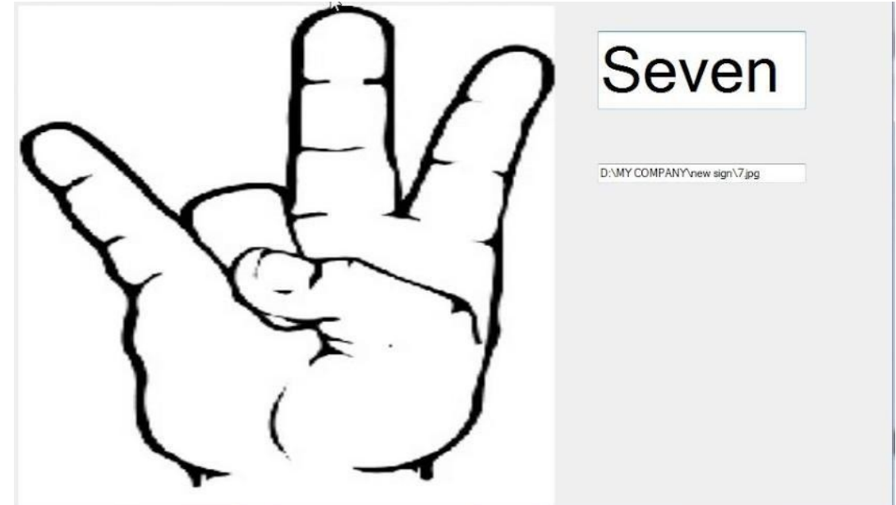
PROPOSED SYSTEM
Algorithmic Design:
Py audio is used to obtain user speech and convert it to text.
The sentence is restructured using stop words removal and lemmatization.
Final ISL gloss is generated by converting text in context free grammar.
YouTube IFrame API is used to display the output in the web application.

Slide 6
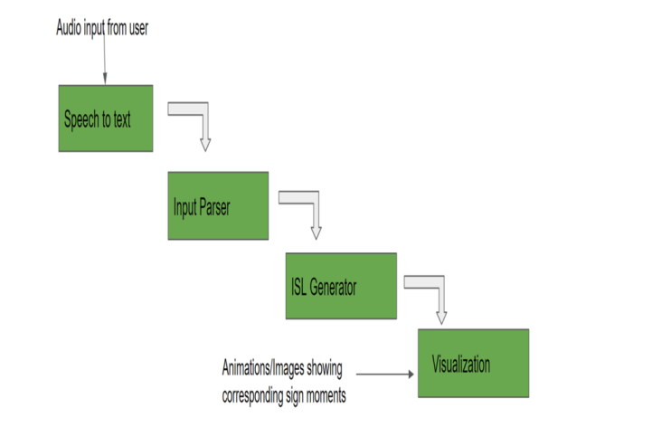
FLOW CHART

Slide 7
SOFTWARE REQUIREMENTS
A web application is implemented using python programming language.
Python includes libraries such as pyaudio to convert speech to text.
Python 3.7.0 is preferred.
Django version 2.1.7
Operating System – Windows.
ISL/ASL data sets from google.

Slide 8
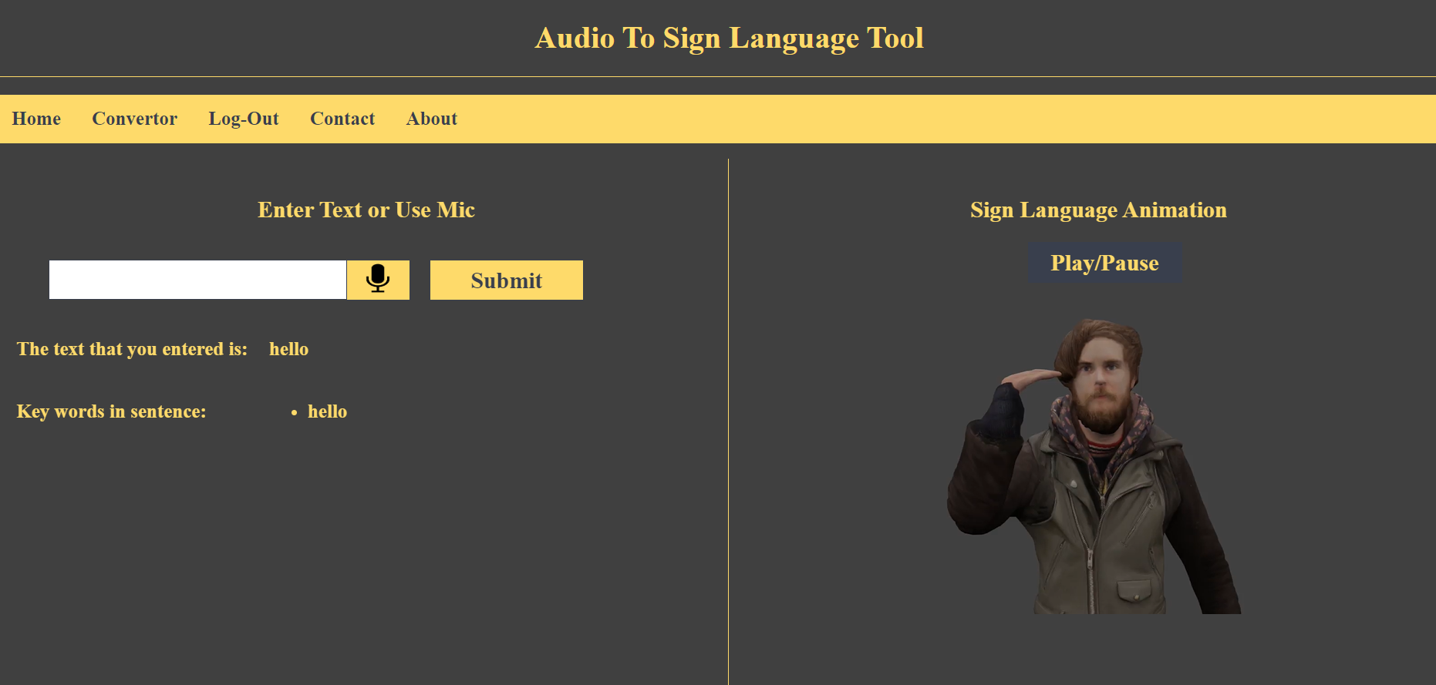
EXPECTED OUTPUT

Slide 9
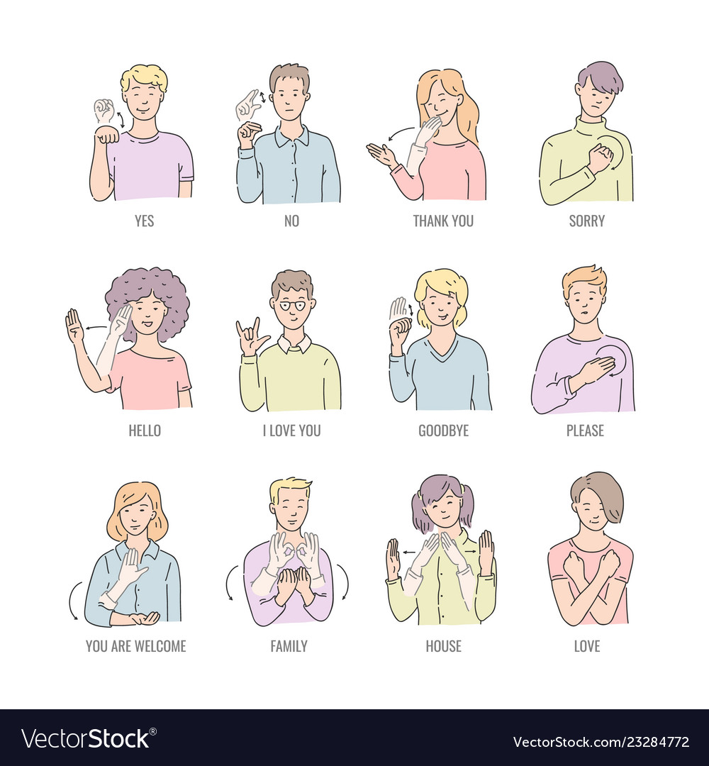

Slide 10
CONCLUSION
We have attempted to create a model that will allow people with disabilities to express themselves distinctly, which will help them blend with the rest of the world without any difficulty. Our proposed model will successfully convert the given input audio into an animation. Many improvements along this route can be made as and when the ISL Dictionary grows.

Slide 11
